Slide 1
Module 4
XML Schema

Slide 2


Module Overview
In this module, you will learn about:
XML Schema
Exploring XML Schemas
Working with Complex Types
Working with Simple Types

Slide 3


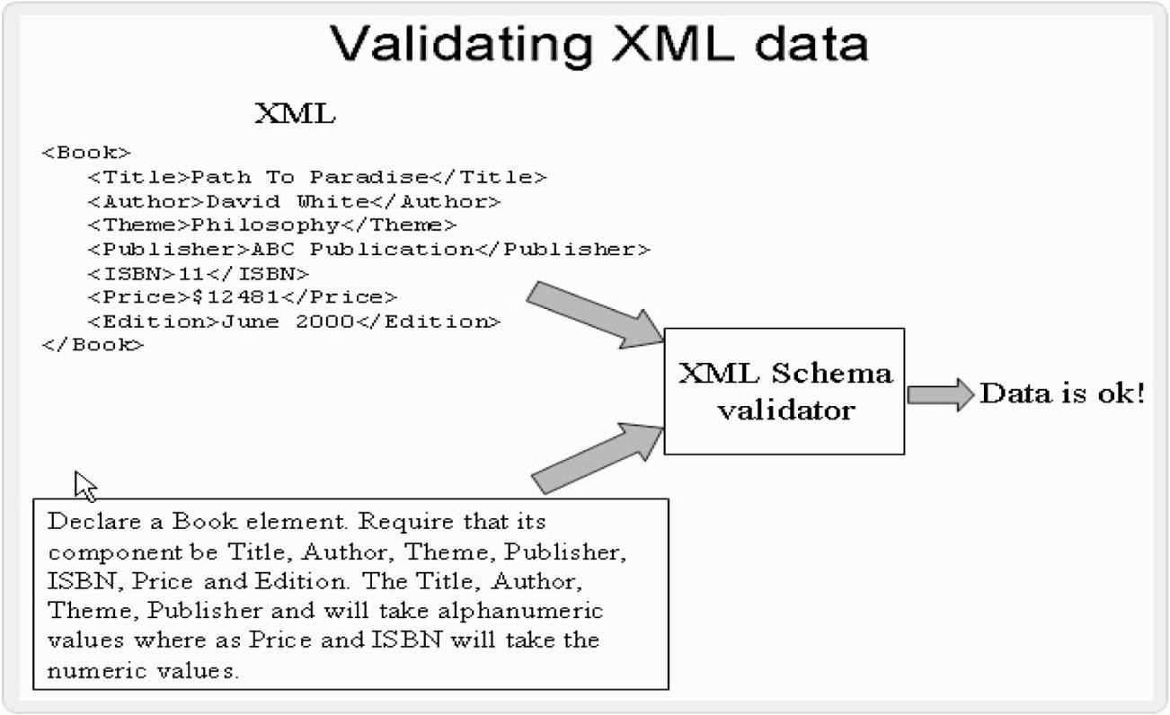
XML Schema
It defines the valid building blocks of an XML document.
XML Schema language is referred as XML Schema Definition (XSD).
It describes the data that is marked up, and also specifies the arrangement of tags and text.
The dictionary defines a schema as “An outline or a model”.

Slide 4


XML Schema Objectives
An XML Schema defines:
Elements and attributes that can appear in a document
Which elements are child elements
The order and number of child elements
Whether an element is empty or can include text
Data types for elements and attributes
Default and fixed values for elements and attributes

Slide 5


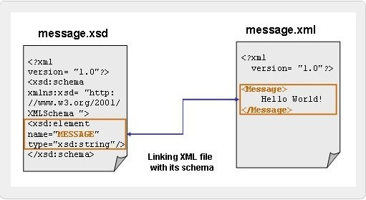
How to write an XML Schema?
XML File
The XML document contains a single element, <Message>.
XSD File
The file is saved with “.xsd” as the extension for storing schema documents

Slide 6

What is an XML Schema? 1-3
XML schemas allow Web applications to exchange XML data
more robustly using the following range of new features:
Schemas support data types
Schemas are portable and efficient
Schemas secure data communication
Schemas are extensible
Schemas catch higher-level mistakes
Schemas support Namespace
Schemas support data types
Support and ability to create the required datatypes has overcome the
drawbacks of DTDs
Easy to define and validate valid document content and data formats
Easy to implement the restrictions on data

Slide 7

What is an XML Schema? 2-3
Schemas are portable and efficient
Portable and efficient
No need to learn any new language or any editor
Similar XML parser can be used to parse the Schema files
Schemas secure data communication
Sender can specify the data in a way that the receiver will understand
Schemas are extensible
It is possible to reuse an existing schema to create another schema
It is possible to create own data types derived from the standard types
Support reference of multiple schemas in the same document

Slide 8


What is an XML Schema? 3-3
Schemas catch higher-level mistakes
Catch higher-level mistakes that arise, such as a required field of information is missing or in a wrong format, or an element name is mis-spelled
Schemas support Namespace
Support for XML Namespaces allows the programmer to validate documents that use markup from multiple namespaces
Constructs can be re-used from schemas already defined in a different namespace

Slide 9


Comparing DTDs with Schemas
Drawbacks of using DTDs are:
DTDs are written in a non-XML syntax
DTDs are not extensible
DTDs do not support namespaces
DTDS offer limited data typing
Sample External DTD File: program.dtd
<!ELEMENT program (comments, code)>
<!ELEMENT comments (#PCDATA)>
<!ELEMENT code (#PCDATA)>

Slide 10


Advantages of XML Schemas over DTD 1-3
XML schema offers a range of new features:
Richer data types
Archetypes
Attribute grouping
Refinable archetypes
Notes:
Archetypes: nguyen mau

Slide 11


Advantages of XML Schemas over DTD 2-3
Sample schema File: mail.xsd
<?xml version="1.0"?>
<xs:schema xmlns:xs="http://www.w3.org/2001/XMLSchema" targetNamespace="http://www.abc.com" xmlns="http://www.abc.com" elementFormDefault="qualified">
<xs:element name="mail">
<xs:complexType>
<xs:sequence>
<xs:element name="to" type="xs:string"/>
<xs:element name="from" type="xs:string"/>
<xs:element name="header" type="xs:string"/>
<xs:element name="body" type="xs:string"/>
</xs:sequence>
</xs:complexType>
</xs:element>
</xs:schema>

Slide 12

Advantages of XML Schemas over DTD 3-3
Sample XML File with a reference to schema: mail.xml
<?xml version="1.0"?>
<mail xmlns="http://www.abc.com"
xmlns:xsi="http://www.w3.org/2001/XMLSchema-instance"
xsi:schemaLocation="http://www.abc.com mail.xsd">
<to>John</to>
<from>Jordan</from>
<header>Scheduler</header>
<body>3rd March Monday, 7:30 PM: board meeting!</body>
</mail>

Slide 13

Data Types Supported by Schema 1-6
XML Schema describes a number of built-in data types, which can be
used to specify and validate the intended data type of the content.
It also allows a user to create a user-defined data type by extending the built-in data types using facets.
XML Schema recommendation defines two sorts of data types:
Built-in data types
User-derived data types
Built-in data types
Available to all XML Schema authors, and should be implemented by a
conforming processor.
User-derived data types
Defined in individual schema instances, and are particular to that
schema.
Notes:
Conform : phu hop

Slide 14

Data Types Supported by Schema 2-6
string | can contain characters, line feeds, carriage returns, and tab characters
boolean | legal values for boolean data type are true and false true can be replaced by the numeric value 1 and false can be replaced by the value 0
numeric | represents a numerical value includes numbers such as whole numbers, and real numbers
dateTime | represents a particular time on a given date, written as a string
binary | include graphic files, executable programs, or any other string of binary data
anyURI | represents a file name or location of the file

Slide 15

Data Types Supported by Schema 3-6
Syntax: string
<xs:element name="element_name" type="xs:string"/>
Syntax: boolean
<xs:attribute name="attribute_name" type="xs:boolean"/>
Syntax: numeric
<xs:element name="element_name" type="xs:numeric"/>

Slide 16
Data Types Supported by Schema 4-6
Syntax: dateTime
<xs:element name="element_name" type="xs:dateTime"/>
Syntax: binary
<xs:element name="image_name" type="xs:hexBinary"/>
Syntax: anyURI
<xs:attribute name="image_name" type="xs:anyURI"/>

Slide 17
Data Types Supported by Schema 5-6
Code Snippet: string
<xs:element name="Customer" type="xs:string"/>
<Customer>John Smith</Customer>
Code Snippet: boolean
<xs:attribute name="Disabled" type="xs:boolean"/>
<Status Disabled="true">OFF</Status>
Code Snippet: numeric
<xs:element name="Price" type="xs:numeric"/>
<Price>500</Price>

Slide 18
Data Types Supported by Schema 6-6
Code Snippet: dateTime
<xs:element name="start" type="xs:dateTime"/>
<start>2001-05-10T12:35:40</start>
Code Snippet: binary
<xs:element name="Logo" type="xs:hexBinary"/>
Code Snippet: anyURI
<xs:attribute name="flower" type="xs:anyURI"/>
<image flower="http://www.creativepictures.com/gallery/flower.gif " />

Slide 19
Additional Data types 1-3
Additional data types are derived from the basic built-in data types,
which are called base type data types.
The generated or derived data types, supported by the XML schema include:
integer
decimal
time
Integer
Base type is numeric data type. Includes both positive and negative numbers. Used to specify a numeric value without a fractional component.
Decimal
Represent exact fractional parts such as 3.26. Base type is numeric data type. Used to specify a numeric value.

Slide 20
Additional Data types 2-3
Time
Base type is the dateTime data type. Default representation is 16:35:26. time data type is used to specify time. Specified as "hh:mm:ss“.
Syntax: integer
<xs:element name="element_name" type="xs:integer"/>
Syntax: decimal
<xs:element name="element_name" type="xs:decimal"/>
Syntax: time
<xs:element name="element_name" type="xs:time"/>

Slide 21
Additional Data types 3-3
Code Snippet: integer
<xs:element name="Age" type="xs:integer"/>
<Age>999</Age>
Code Snippet: decimal
<xs:element name="Weight" type="xs:decimal"/>
<prize>+70.7860</prize>
Code Snippet: time
<xs:element name="BeginAt" type="xs:time"/>
<BeginAt>09:30:10.5</BeginAt>

Slide 22
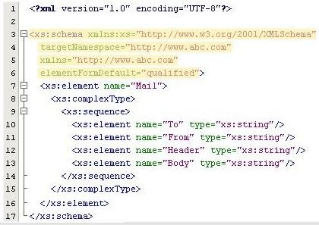
Schema Vocabulary 1-3
Creating a schema using XML schema vocabulary is like creating
any other XML document using a specialized vocabulary.
Every XML Schema starts with the root element <schema>.
The code indicates that that the elements and data types used in the schema are derived from the “http://www.w3.org/2001/XMLSchema” namespace and prefixed with xs.
It specifies that the elements defined in an XML document that refers this schema, come from the “http://www.abc.com” namespace.

Slide 23


Schema Vocabulary 2-3
This line of code points to “http://www.abc.com” as the default namespace.
It indicates that elements used by the XML instance document which were declared in this schema needs to be qualified by the namespace.

Slide 24
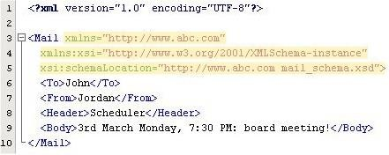
Schema Vocabulary 3-3
It indicates the default namespace declaration. This declaration informs the schema-validator that all the elements used in this XML document are declared in the default (“http://www.abc.com”) namespace.
This is the instance namespace available for the XML schema.
This schemaLocation attribute has two values. The first value identifies the namespace. The second value is the location of the XML schema where it is stored.

Slide 25


Complex Types 1-4
A schema assigns a type to each element and
attribute it declares.
Elements with complex type may contain nested elements and have attributes.
Only elements can contain complex types. Complex
type elements have four variations. They are:
Empty Elements
Only Elements
Only Text
Mixed

Slide 26
Complex Types 2-4
Empty elements
Empty elements optionally specify attributes types, but do not permit
content.
<xs:element name="Books">
<xs:complexType>
<xs:attributename="BookCode" type="xs:positiveInteger"/>
</xs:complexType>
</xs:element>
Only Elements
These elements can only contain elements and do not contain attributes.
<xs:element name="Books">
<xs:complexType>
<xs:sequence>
<xs:element name="ISBN" type="xs:string"/>
<xs:element name="Price" type="xs:string"/>
</xs:sequence>
</xs:complexType>
</xs:element>

Slide 27

Complex Types 3-4
Only Text
These elements can only contain text and optionally may or may not have attributes.
<xs:complexType name="Books">
<xs:simpleContent>
<xs:extension base="xs:string">
<xs:attribute name="BookCode" type="xs: positiveInteger"/>
</xs:extension>
</xs:simpleContent>
</xs:complexType>

Slide 28
Complex Types 4-4
Mixed
These are elements that can contain text content as well as sub-
elements within the element. They may or may not have attributes.
<xs:element name="Books">
<xs:complexType mixed="true">
<xs:sequence>
<xs:element name="BookName" type="xs:string"/>
<xs:element name="ISBN" type="xs:positiveInteger"/>
<xs:element name="Price" type="xs:string"/>
</xs:sequence>
</xs:complexType>
</xs:element>
A complex element can be defined in two different ways:
By directly naming the element
By using the name and type attribute of the complex type

Slide 29
Defining Complex Types 1-2
By directly naming the element
Code Snippet
<xs:element name=”Student”>
<xs:complexType>
<xs:sequence>
<xs:element name=”FirstName” type=”xs:string”/>
<xs:element name=”MiddleName” type=”xs:string”/>
<xs:element name=”LastName” type=”xs:string”/>
</xs:sequence>
</xs:complexType>
</xs:element>

Slide 30
Defining Complex Types 2-2
By using the name and type attribute of the
complex type
Code Snippet
<xs:element name=”Student” type=”PersonInfo”/>
<xs:complexType name=”personinfo”>
<xs:sequence>
<xs:element name=”FirstName” type=”xs:string”/>
<xs:element name=”LastName” type=”xs:string”/>
</xs:sequence>
</xs:complexType>

Slide 31
minOccurs and maxOccurs 1-3
minOccurs
It specify the minimum number of occurrences of the element in an XML document.
maxOccurs
It specify the maximum number of occurrences of the element in an XML document.

Slide 32
minOccurs and maxOccurs 2-3
Code Snippet
…
<xs:element name= “Books”>
<xs:complexType>
<xs:sequence>
<xs:element name=”ISBN” type=”xs:string”/>
<xs:element name=”Quantity” type=”xs:string” maxOccurs=”100” minOccurs=”0”/>
</xs:sequence>
</xs:complexType>
</xs:element>
…

Slide 33
minOccurs and maxOccurs 3-3
minOccur | MaxOccur | Number of times an element can occur
0 | 1 | 0 or 1
1 | 1 | 1
0 | * | Infinite
1 | * | At least once
>0 | * | At least minOccurs times
>maxOccurs | >0 | 0
Any value | <minOccurs | 0

Slide 34
Element Content 1-2
Code Snippet
// Books.xml
<?xml version=”1.0”?>
<Books xmlns:xsi=”http://www.w3.org/2001/XMLSchema-instance” xsi:noNamespaceSchemaLocation= “Books.xsd”>
<Title>A cup of tea</Title>
<Author>
<Name>Dennis Compton</Name>
</Author>
<Author>
<Name>George Ford</Name>
</Author>
<Publisher>
<Name>Orange</Name>
</Publisher>
</Books>

Slide 35
Element Content 2-2
Code Snippet
// Books.xsd
<?xml version=”1.0”?>
<xs:schema xmlns:xsd=”http://www.w3.org/2001/XMLSchema”>
<xs:element name= “Books” type= “BookType”>
<xs:complexType name= “AuthorType”>
<xs:sequence>
<xs:element name= “Name” type=”xs:string”/>
</xs:sequence>
</xs:complexType>
<xs:complexType name= “PublisherType”>
<xs:sequence>
<xs:element name= “Name” type= “xs:string”/>
</xs:sequence>
</xs:complexType>
<xs:complexType name= “BookType”>
<xs:sequence>
<xs:element name= “Title” type= “xs:string”/>
<xs:element name= “Author” type=”ComposerType” maxOccurs= “unbounded”/>
<xs:element name= “Publisher” type=”PublisherType”
minOccurs=”0” maxOccurs= “unbounded”/

Slide 36
Mixed Content
Code Snippet
// Book.xml
<Books>
Apocalypse written by<Author>Mary Jane</Author> is of Genre<Category>Fiction</Type>.
</Books>
// Book.xsd
<xs:element name=”Books”>
<xs:complexType mixed=”true”>
<xs:sequence>
<xs:element name=”Author” type=”xs:string”/>
<xs:element name=”Category” type=”xs:string”/>
</xs:sequence>
</xs:complexType>
</xs:element>

Slide 37
Grouping Constructs 1-3
xs:all
This grouping construct requires that each element in the group must occur at most once
Code Snippet
<xs:element name= “Books”>
<xs:complexType>
<xs:all>
<xs:element name=”Name” type=”xs:string” minOccurs= “1” maxOccurs= “1”/>
<xs:element name=”ISBN” type=”xs:string” minOccurs= “1” maxOccurs= “1”/>
<xs:element name=”items” type=”Items” minOccurs= “1” />
</xs:all>
</xs:complexType>
</xs:element>

Slide 38
Grouping Constructs 2-3
xs:sequence
It specifies each member of the sequence to appear in the same order
Code Snippet
<xs:element name=”Books”>
<xs:complexType>
<xs:sequence>
<xs:element name=”Name” type=”xs:string” />
<xs:element name=”ISBN” type=” xs:string “ />
<xs:element name=”Price” type=” xs:string “ />
</xs:sequence>
</xs:complexType>
</xs:element>

Slide 39
Grouping Constructs 3-3
xs:choice
It will allow only one of the choices to appear instead of requiring all the elements to be present
Code Snippet
<xs:complexType name=”AdressInfo”>
<xs:group>
<xs:choice>
<xs:element name=”Address” type=”USAddress” />
<xs:element name=”Address” type=”UKAddress” />
<xs:element name=”Address” type=”FranceAddress” />
</xs:choice>
</xs:group>

Slide 40
Defining a Simple Type Element
They are used to form the textual data and specify the type of
data allowed within attributes and elements.
Syntax
<xs:element name=”XXXX” type=”YYYY”/>
Code Snippet
Book.xml: XML Elements
<Book_name>The Da vinci code</Book_name>
<TotalNoOfPages>360</TotalNoOfPages>
<Author_name>Dan Brown</Author_name>
Book.xsd: Corresponding simple element definitions
<xs:element name=”Book_name” type=”xs:string” />
<xs:element name=”TotalNoOfPages” type=”xs:integer”/>
<xs:element name=”Author_name” type=”xs:string”/>

Slide 41
Data types used with Simple types
Built-in simple type
User-defined simple type

Slide 42
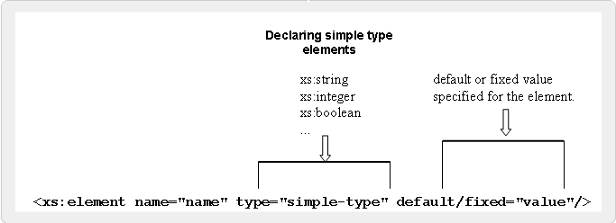
Built-in Simple types 1-2
There are several built-in simple types, such as
integer, date, float and string.
It can contain a default value or a fixed value.

Slide 43
Built-in Simple types 2-2
Syntax
<xs:element name=”XXXX” type=”YYYY” default=”ZZZZ”/>
Code Snippet
<xs:element name=”AccountType” type=”xs:string”
fixed=”Savings”/>
<xs:element name=”BalanceAmount” type=”xs:integer” default=”5000”/>

Slide 44
User-defined Simple types 1-2
Custom user defined datatype can be created using
the <simpleType> definition.
Syntax
<xs:simpleType name=”name of the simpleType”>
<xs:restriction base=”built-in data type”>
<xs:constraint=”set constraint to limit the content”/>
</xsd:restriction>
</xsd:simpleType>

Slide 45

User-defined Simple types 2-2
Code Snippet 1
<xs:simpleType name=”AngleMeasure”>
<xs:restriction base=”xs:integer”>
<xs:minInclusive value=”0”/>
<xs:maxInclusive value=”360”/>
</xs:restriction></xs:simpleType>
Code Snippet 2
<xs:simpleType name=”triangle”>
<xs:restriction base=”xsd:string”>
<xs:enumeration value=”isosceles”/>
<xs:enumeration value=”right-angled”/>
<xs:enumeration value=”equilateral”/>
</xs:restriction>
</xs:simpleType>

Slide 46
Restrictions 1-2
It can be specified for the simpleType elements.
They are declared using the <restriction> declaration.
Syntax
<restriction base=”name of the simpleType you are
deriving from”>
In this <restriction> declaration, the base data type can be specified using the base attribute.
Code Snippet
<xs:simpleType name=”Age”>
<xs:restriction base=”xs:integer”>
...
...
</xs:restriction>
</xs:simpleType>

Slide 47
Restrictions 2-2
Syntax
<xs:simpleType name= “name”>
<xs:restriction base= “xs:source”>
<xs:facet value= “value”/>
<xs:facet value= “value”/>
…
</xs:restriction>
</xs:simpleType>
Code Snippet
<xs:simpleType name=”triangle”>
<xs:restriction base=”xs:string”>
<xs:enumeration value=”isosceles”/>
<xs:enumeration value=”right-angled”/>
<xs:enumeration value=”equilateral”/>
</xs:restriction>
</xs:simpleType>

Slide 48
Facets 1-2
They are used to restrict the set or range of values a datatype can contain.
There are 12 facet elements declared using a common syntax.
Facet | Description
minExclusive | Specifies the minimum value for the type that excludes the value provided.
minInclusive | Specifies the minimum value for the type that includes the value provided.
maxExclusive | Specifies the maximum value for the type that excludes the value provided.
maxInclusive | Specifies the maximum value for the type that includes the value provided.
totalDigits | Specifies the total number of digits in a numeric type.
fractionDigits | Specifies the number of fractional digits in a numeric type.
length | Specifies the number of items in a list type or the number of characters in a string type.
minLength | Specifies the minimum number of items in a list type or the minimum number of characters in a string type.
maxLength | Specifies the maximum number of items in a list type or the maximum number of characters in a string type.
enumeration | Specifies an allowable value in an enumerated list.
whiteSpace | Specifies how whitespace should be treated within the type.
pattern | Restricts string types.

Slide 49
Facets 2-2
Syntax
<xs:simpleType name= “name”>
<xs:restriction base= “xs:source”>
<xs:facet value= “value”/>
<xs:facet value= “value”/>
…
</xs:restriction>
</xs:simpleType>
Code Snippet
<xs:simpleType name=”triangle”>
<xs:restriction base=”xs:string”>
<xs:enumeration value=”isosceles”/>
<xs:enumeration value=”right-angled”/>
<xs:enumeration value=”equilateral”/>
</xs:restriction>
</xs:simpleType>

Slide 50
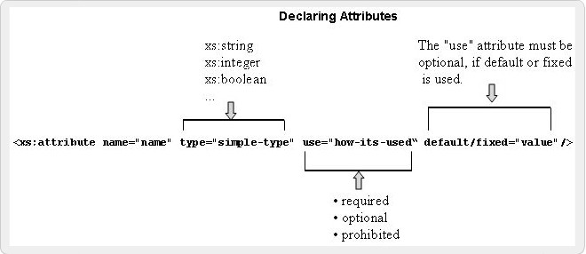
Attributes 1-3
Default
Fixed
Optional
Prohibited
Required

Slide 51
Attributes 2-3
Syntax
<xs:attribute name=”Attribute_name” type=”Attribute_datatype”/>
where,
Attribute_name is the name of the attribute.
Attribute_datatype specifies the data type of the
attribute. There are lot of built in data types in XML schema such as string, decimal, integer, boolean, date, and time.

Slide 52
Attributes 3-3
Code Snippet
....
<xs:complexType name= “SingerType”>
<xs:sequence>
<xs:element name= “Name”>
<xs:complexType>
<xs:all>
<xs:element name= “FirstName” type=”xs:string”/>
<xs:element name= “LastName” type=”xs:string”/>
</xs:all>
</xs:complexType>
</xs:element>
</xs:sequence>
<xs:attribute name= ”age” type=”xs:positiveInteger” use= “optional/>
</xs:complexType>
....

Slide 53
Summary 1-3
XML Schema
An XML Schema is an XML based alternative to DTDs, which describes the structure of an XML document.
An XML Schema can define elements, attributes, child elements and the possible values that can appear in a document.
Schemas overcome the limitations of DTDs and allow Web applications to exchange XML data robustly, without relying on adhoc validation tools.
Exploring XML Schemas
XML schema offers built-in and user defined data types.
It supports built-in data types like string, boolean, number, dateTime, binary, and uri.
It also supports integer, decimal, time, and user-defined
data types.
@ Aptech Limited Modern Markup for Data Interchange/ Module 4/ 61 of 63

Slide 54
Summary 2-3
Working with Complex Types
Elements with complex type may contain nested elements and have attributes.
A complex element can be defined by directly naming the element and by using the name and the type attribute of the complex type.
minOccurs and maxOccurs specify the minimum and maximum number of occurrences of the element in an XML document respectively.
Element content in an XML document contains only XML elements and mixed content contains text mixed with elements.
The grouping constructs in XML schema specify the order of XML elements.

Slide 55
Summary 3-3
Working with Simple Types
The elements of simple type describe the content and data type of the element rather than its structure.
The simple type can have built-in and user defined data types.
Simple type definition takes one of the two values, default or fixed as per the requirement.
The user-defined data type can be derived from a built-in type or an existing simple type.
Use of restrictions and facets restricts its content to user
prescribed values.
Schema supports usage of attributes in elements, which is declared with a simple type definition.

